Slide 1
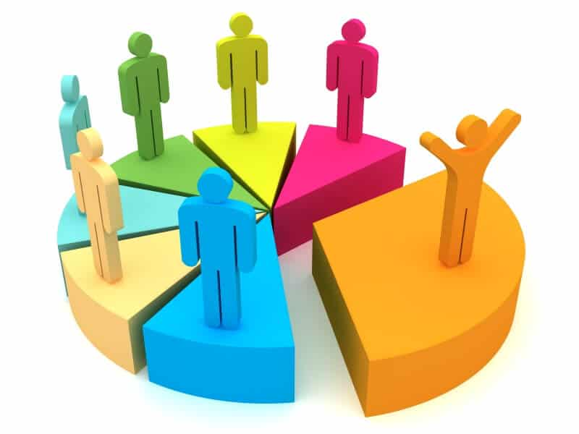
Customer Segmentation

Slide 2
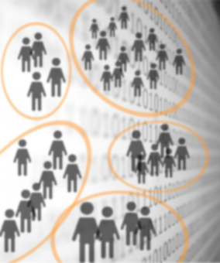
Customer Segmentation
Businesses can use Customer Segmentation for the following:
To develop and personalize unique products and services for a specific group of customers to provide exceptional customer experience.
To develop better communication techniques and send the right marketing messages to the right people.
To identify new opportunities from trends revealed in customer segmentation
Method:
Using the clustering technique of unsupervised learning, we were able to segment the customers into groups that have similar spending habits.
In this project, we built our segmentation model using unsupervised learning by implementing the K-means algorithm to cluster the customers into groups. We implemented it using scikit-learn library.

Slide 3
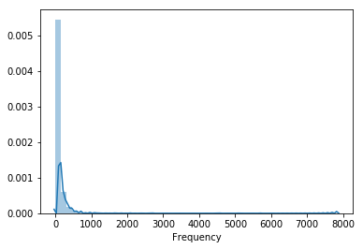
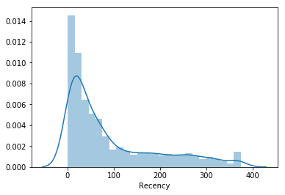
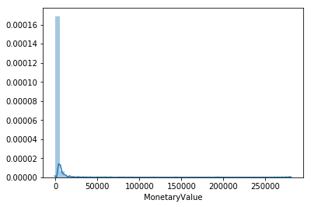
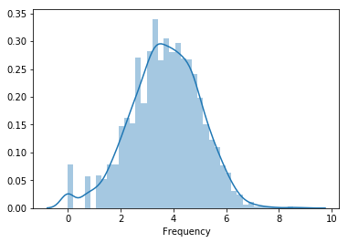
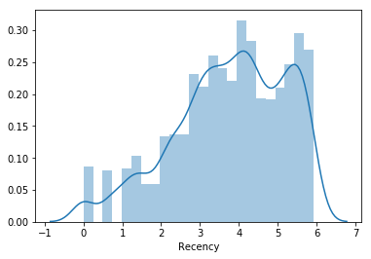
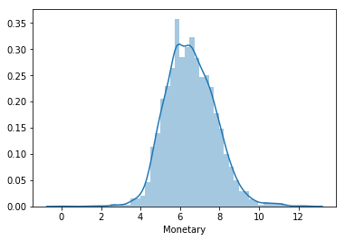
RFM-(RECENCY, FREQUENCY AND MONETARY)
Log Transformation to make it less skewed

Slide 4
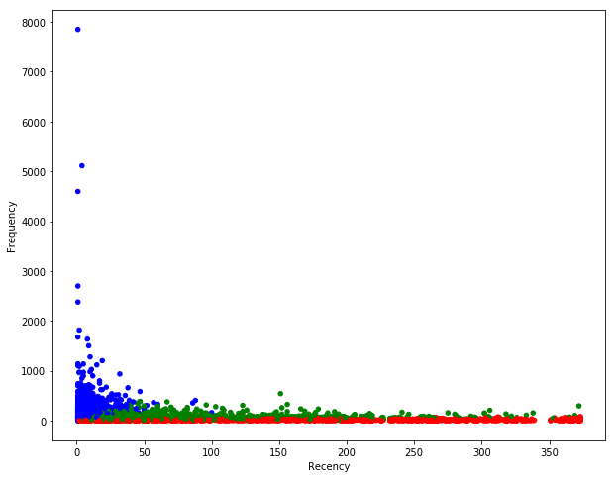
K-MEANS CLUSTERING ANAYLSIS
Cluster 1 and 2: Loyal customers since they have higher spending scores.
Deliberate on new ways to target advertising, pricing, branding, etc. to Cluster 3 i.e. those with high income but low spending score, to see if their spending score would improve.

Slide 5
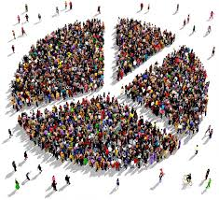
RECAP
Calculate RFM score.
Average of RFM
Unskew the data – log transformation.
Standardize to the same average values.
Scale to the same standard deviation.
Store as a separate array to be used for clustering.
K-means graph

Slide 6


